Slide 1
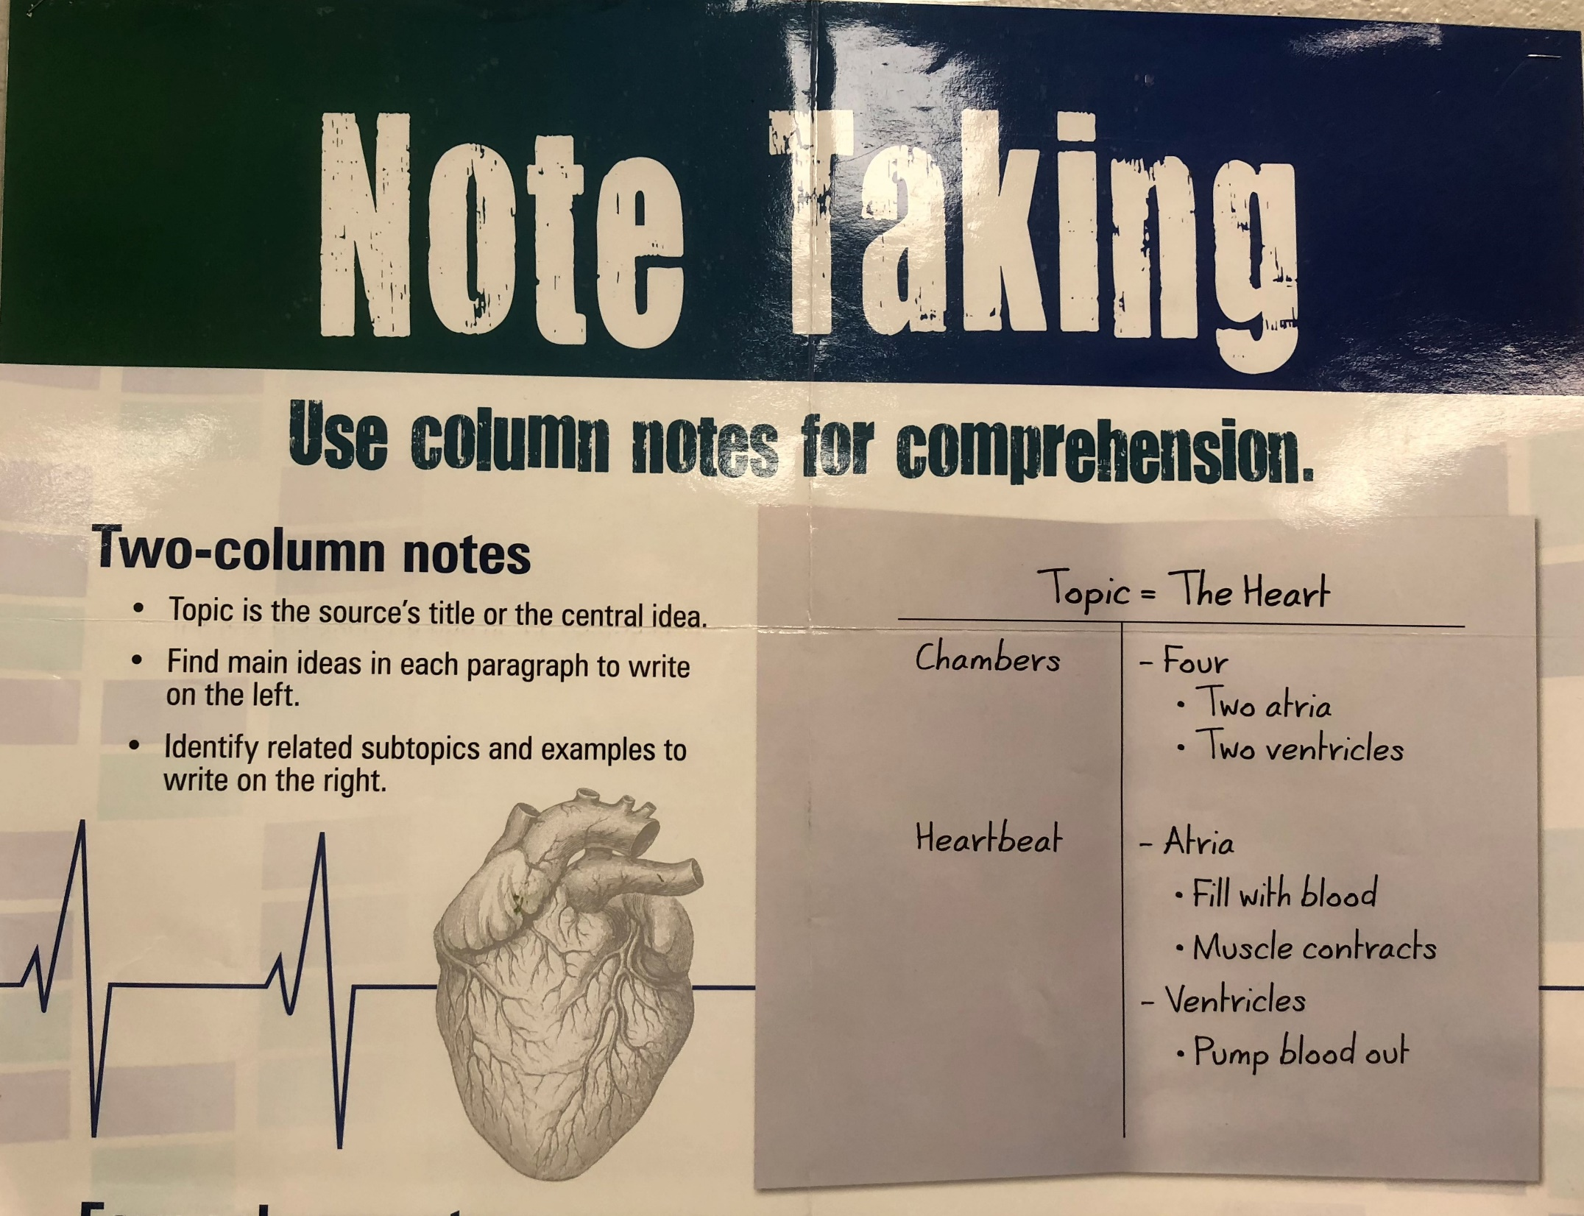

Slide 2
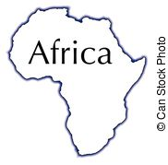
population: 915 million; 12.5% of world’s population
Area: 11.7 million; 20% of the world’s land
Nile River longest river 4,160 mi.
The Sarah desert covers much of northern Africa

Slide 3
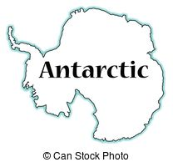
Ice covered continent bordered by the Southern Ocean
It is the windiest, driest, and least populated
There are no permanent residents on this island

Slide 4
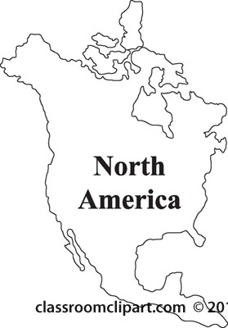
Population: 512 million, 13% of world’s population
Grand Canyon and Mississippi River are land features
Mississippi River: 3,877 mi.
Area: 9.4 million square mi.; 17% of world’s land

Slide 5
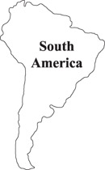
Population: 371 million; 5% of world’s population
Amazon River: 3,915 mi.
Area: 6.9 million square mi; 12% of world’s land

Slide 6
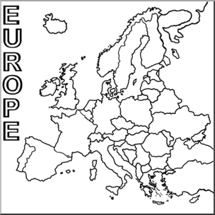
Population: 807 million people
The Urals mountain range divides Europe from Asia
Area: 8.9 million square miles; only 7% of world’s land

Slide 7
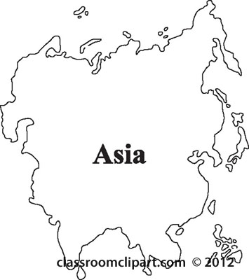
population: 3.6 billion; 60% of the world’s population is here
Area: 19.2 million square mi.; 30 % of the world’s land
Highest mountain: Mt. Everest; 29,028 ft.
Longest river: Chang Jiang; 3,434 mi.

Slide 8
Also known as Australia
Population: 34 million
Made up of thousands of islands some as small as a soccer field
Area: 3.3 million square miles
Oceania

